Slide 1
GPK.Battles Game
Testing Report
Abhijit Roy

Slide 2
Content
Run-4
Run-5
Run-6

Slide 3
RUN-4
Case-1.1: when 1 player selects cards => 1 defaulter

Slide 4
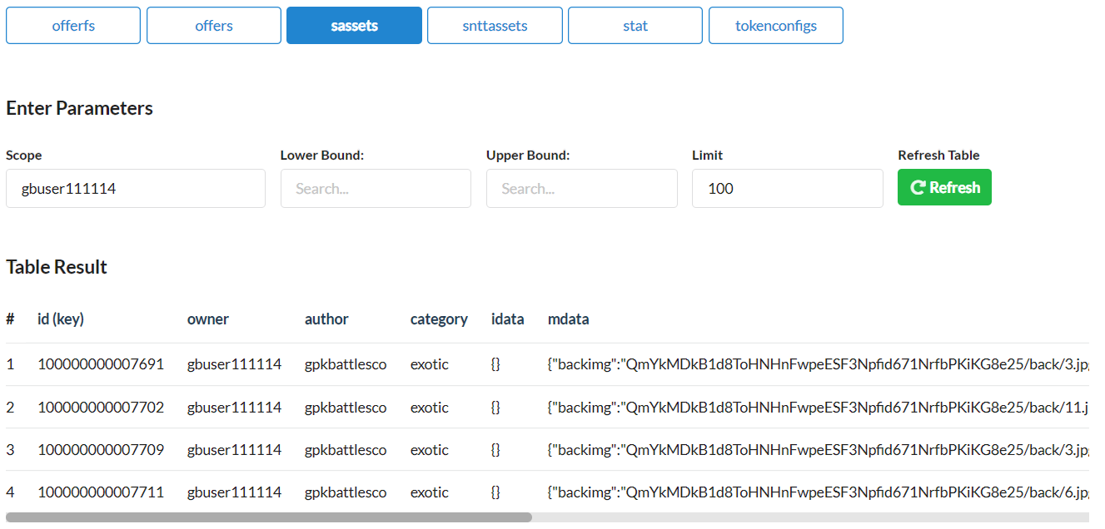
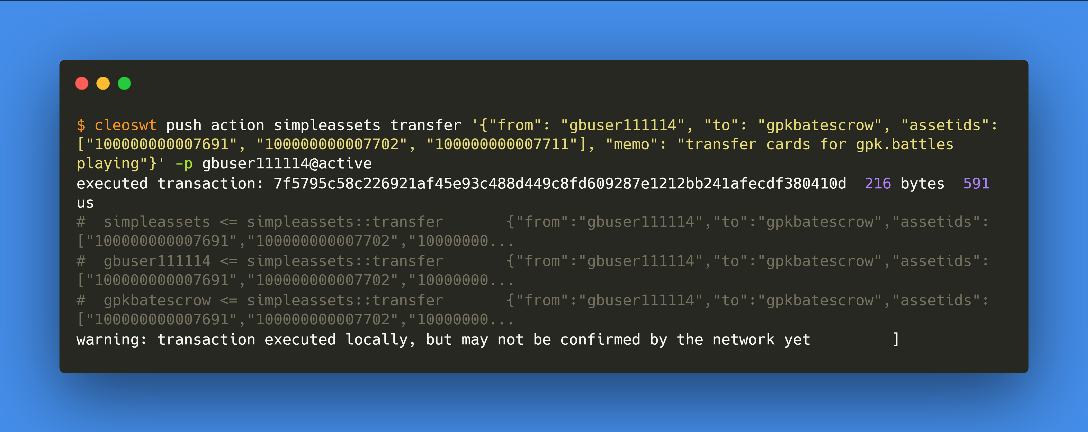
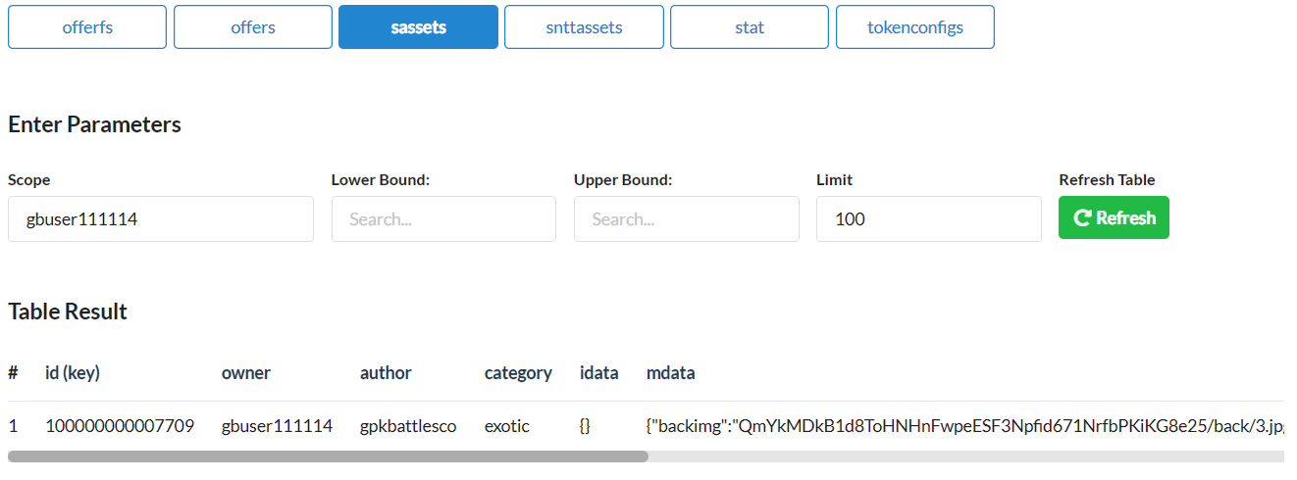
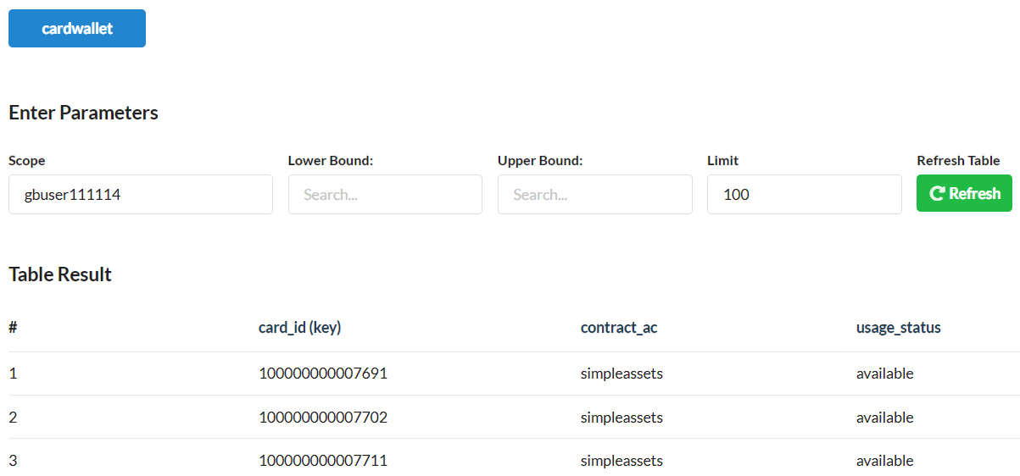
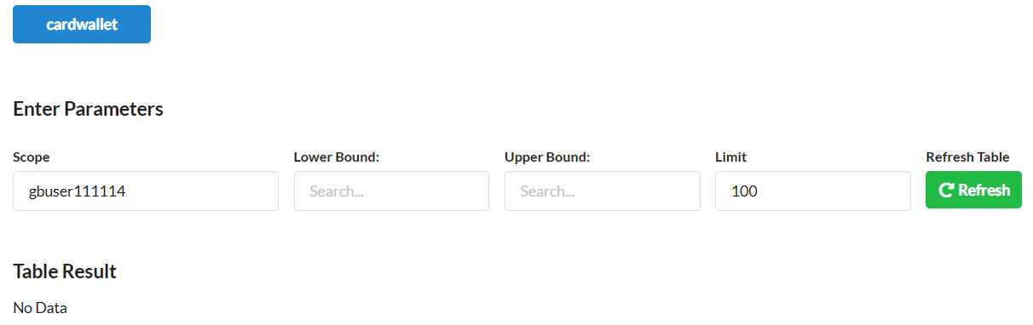
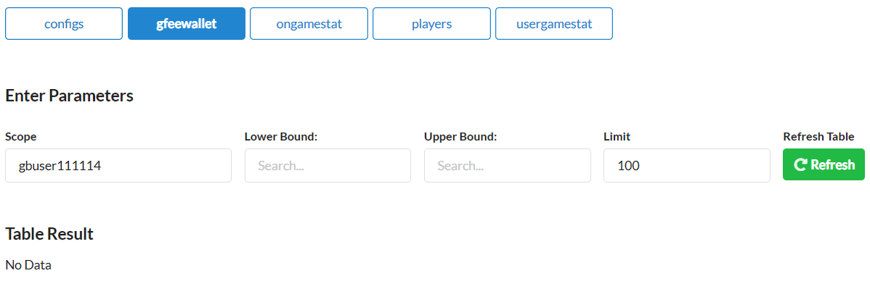
1.
gbuser111114
transfer desired cards to escrow contract
gpkbatescrow
Pre
Activity
Post
sassets
sassets
cardwallet
cardwallet
gfeewallet
gfeewallet

Slide 5

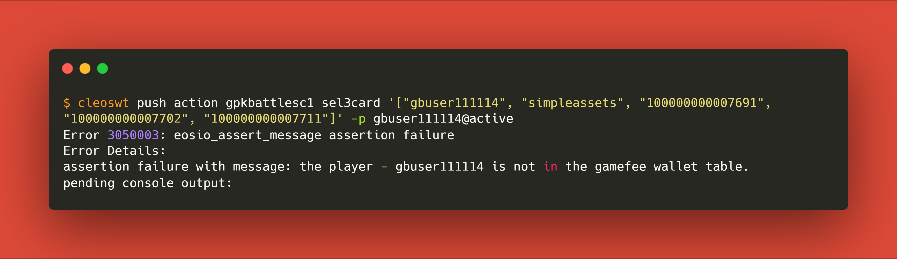
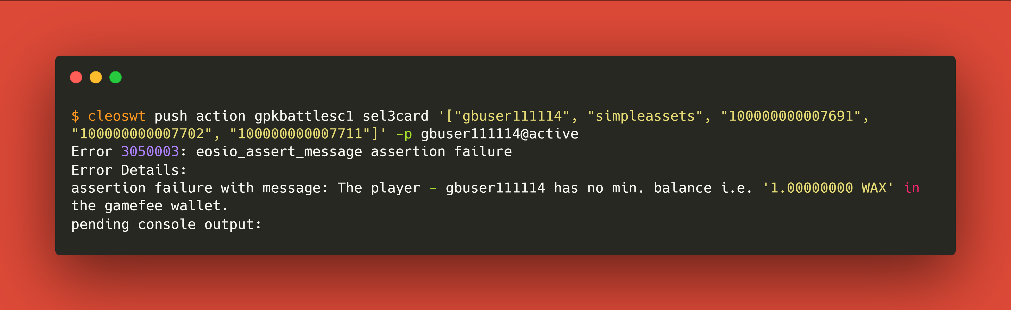
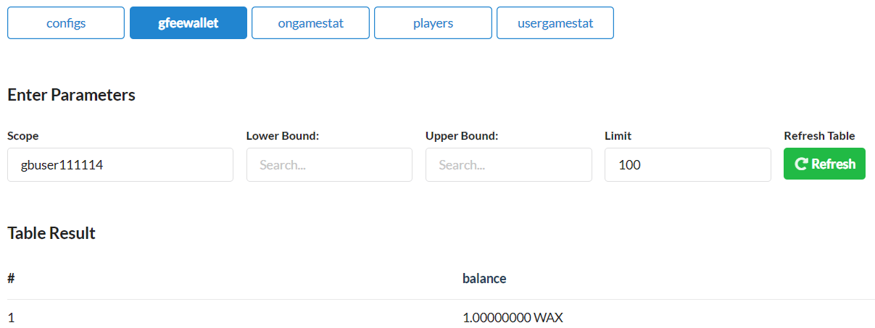
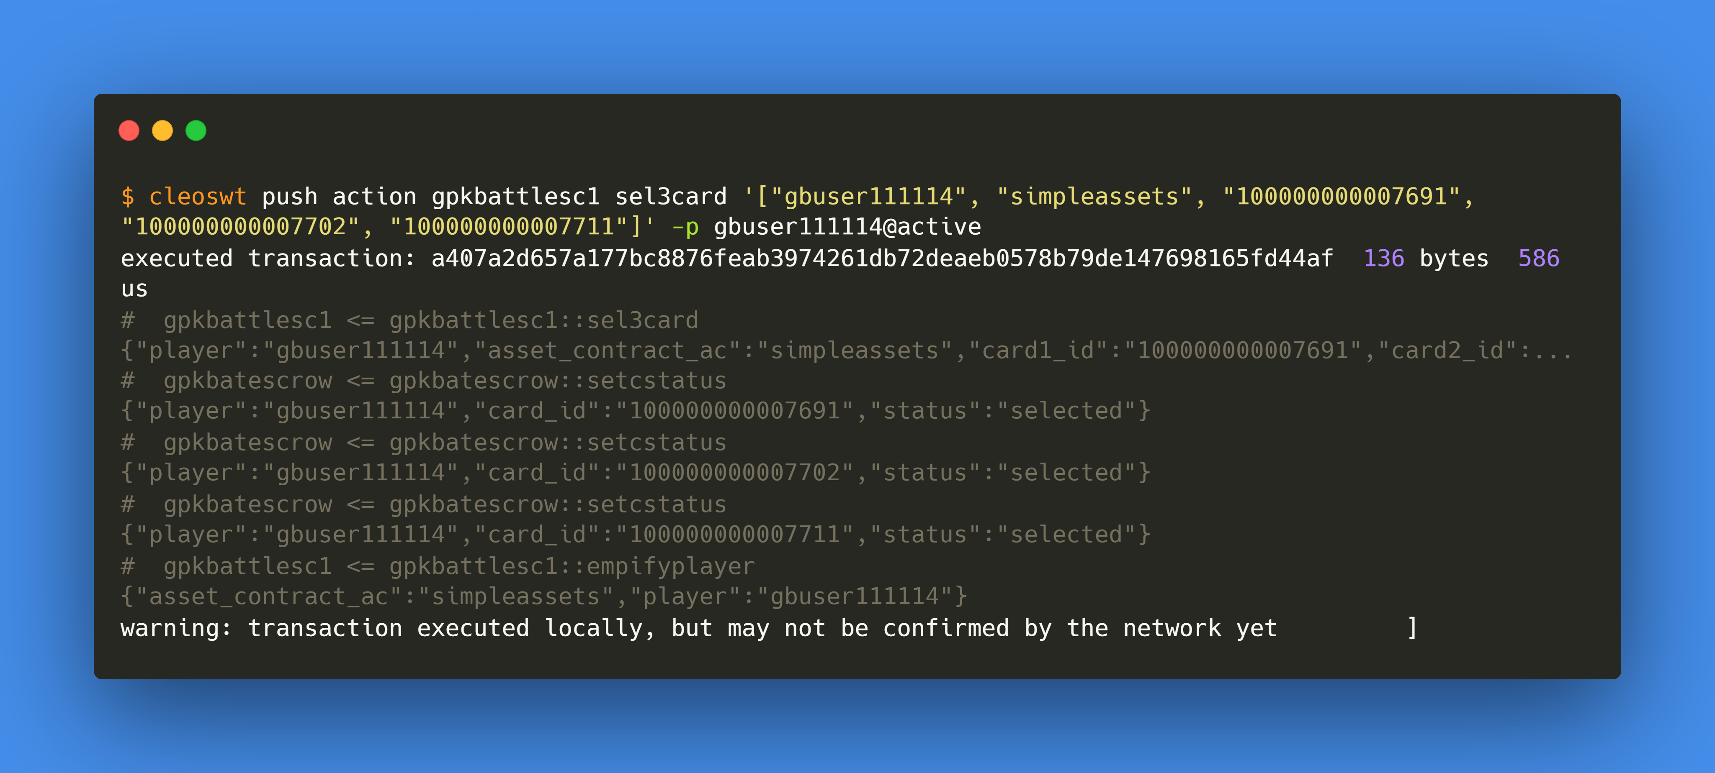
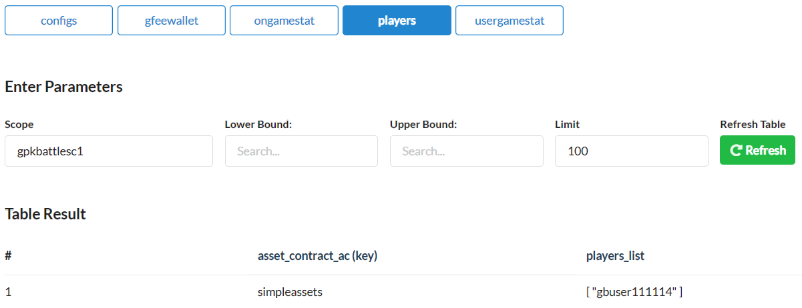
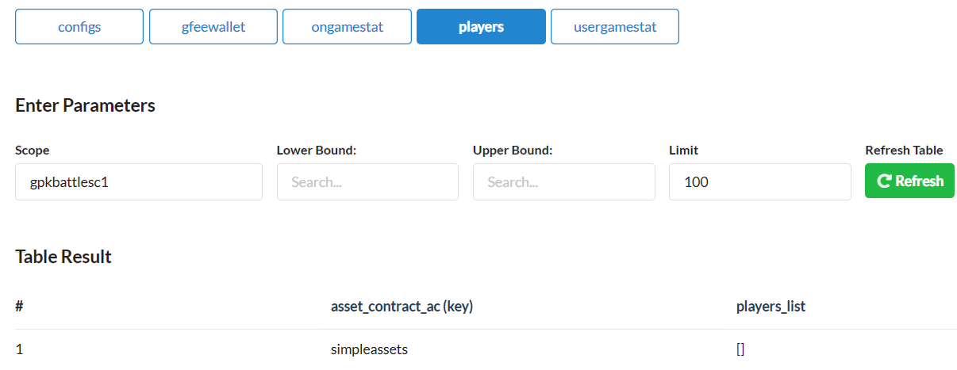
2.
gbuser111114
select 3 cards
Pre
Activity
Post
cardwallet
cardwallet
gfeewallet
gfeewallet
players
players

Slide 6
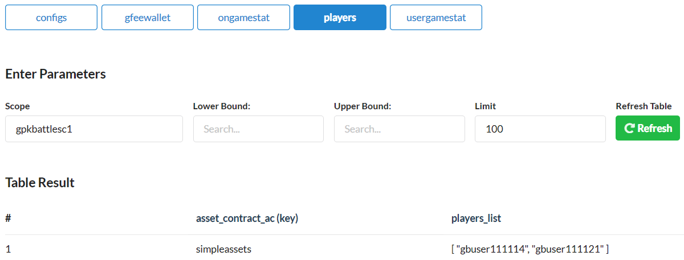
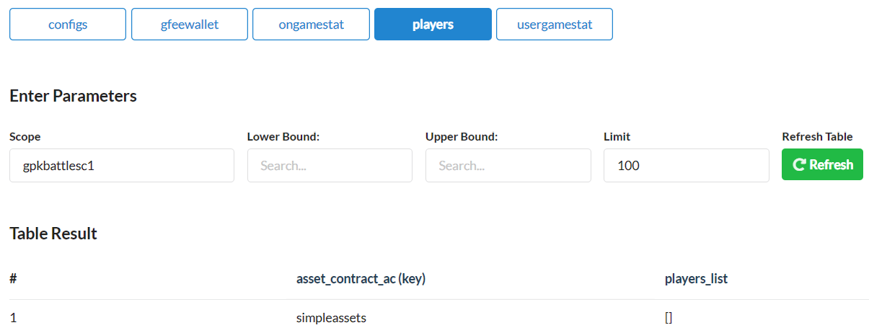
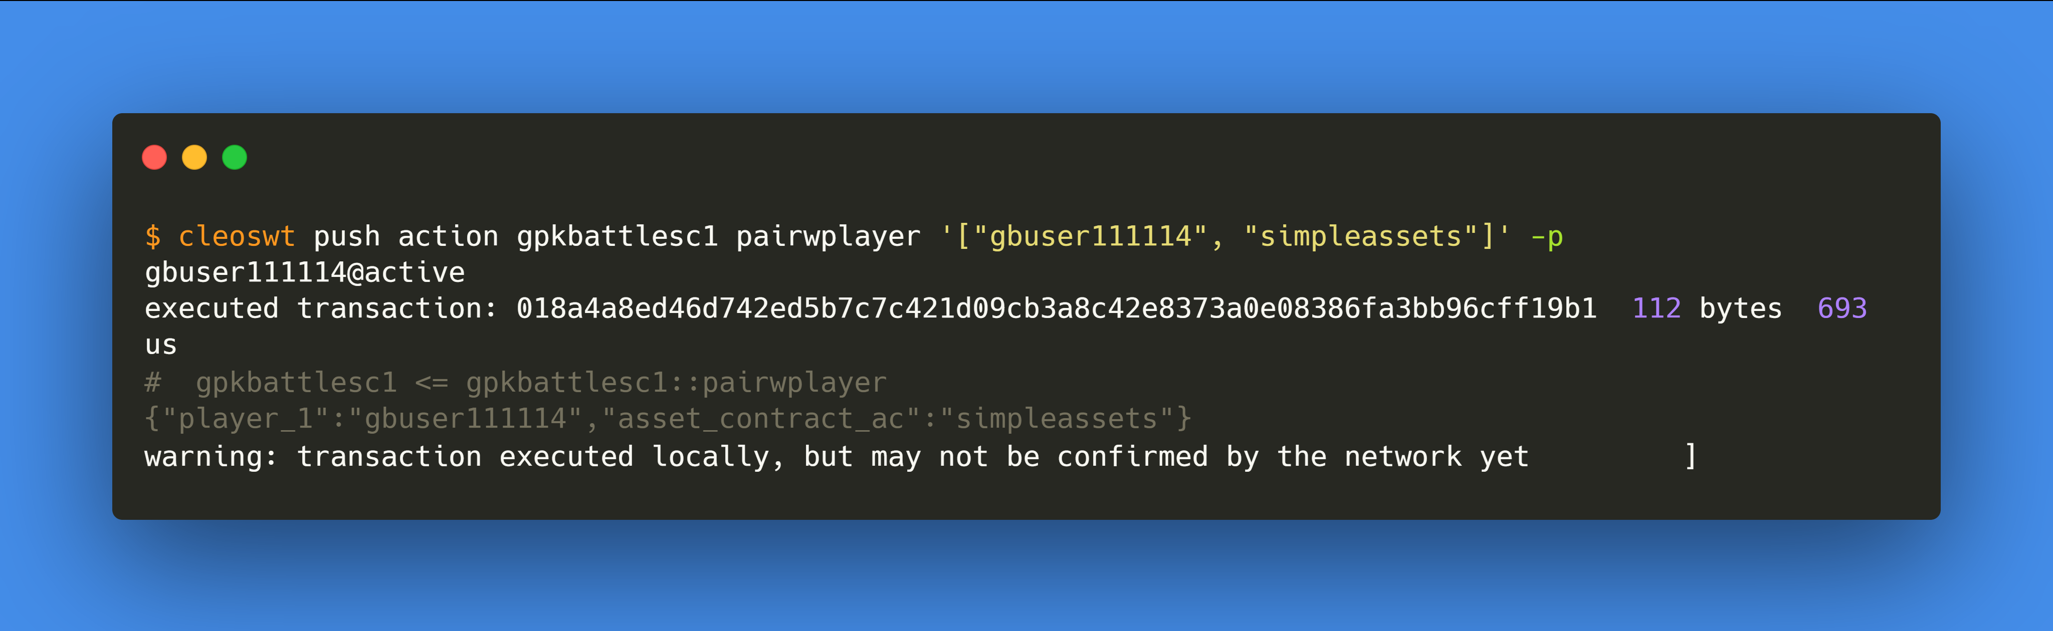
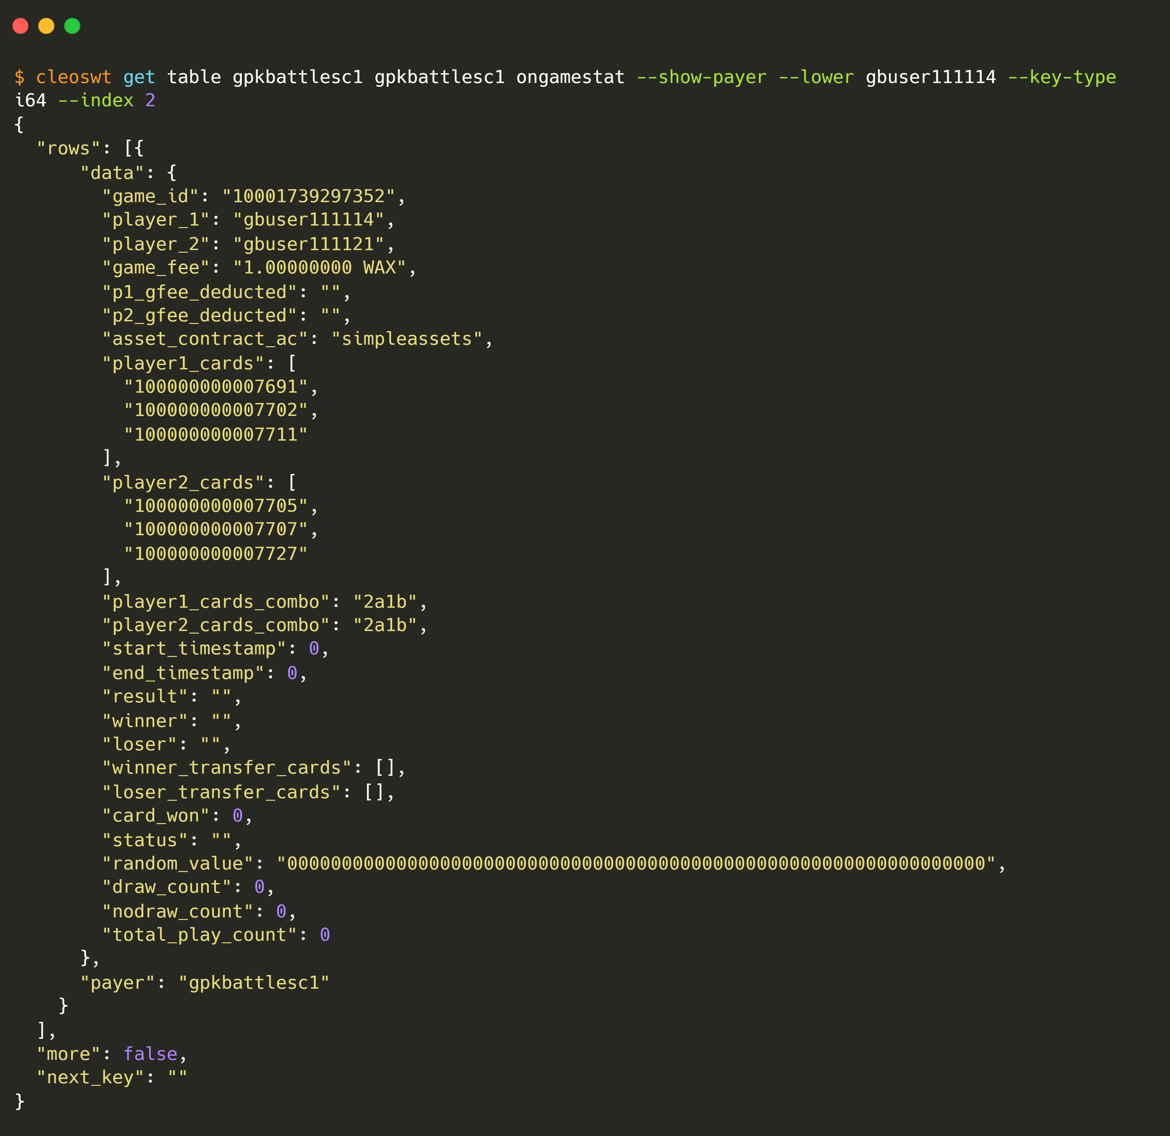
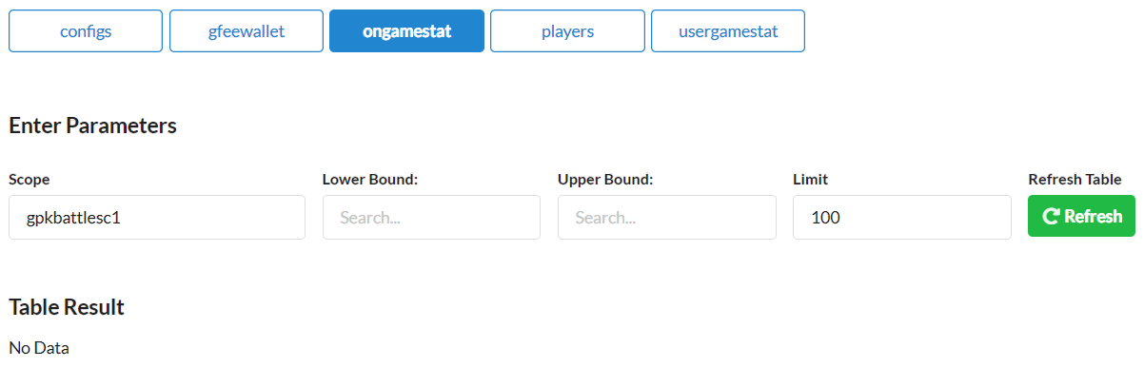
3.
gbuser111114
pairs with a player
Pre
Activity
Post
players
players
ongamestat
ongamestat
gfeewallet
gfeewallet

Slide 7
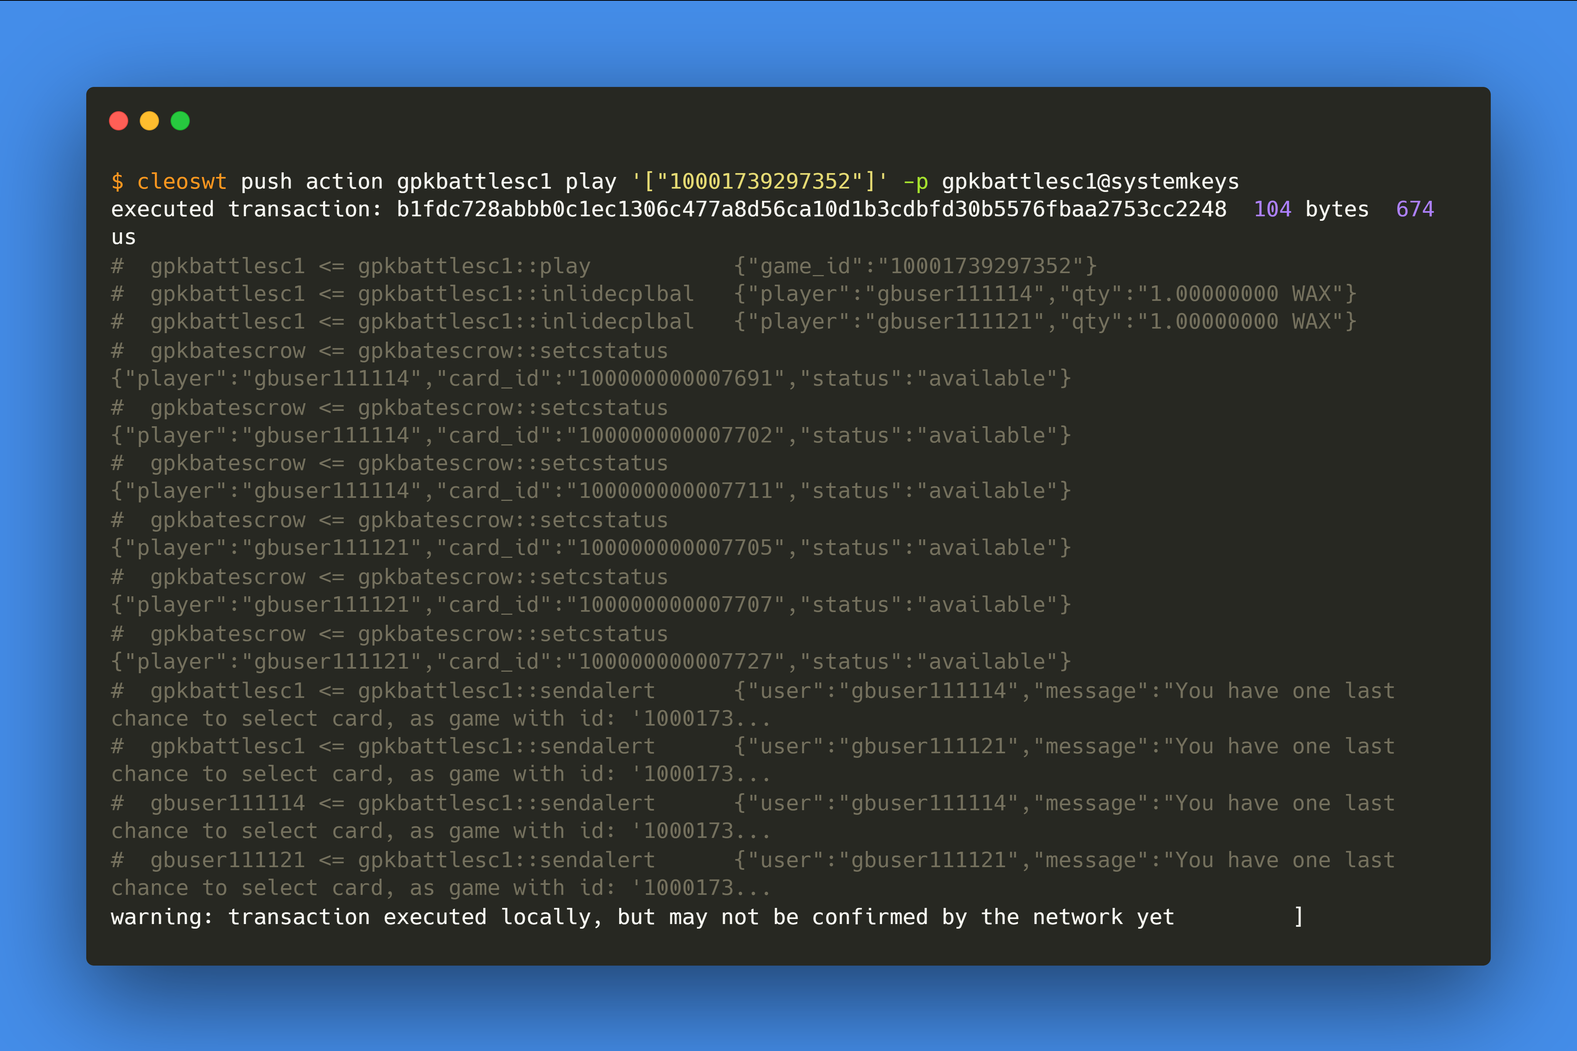
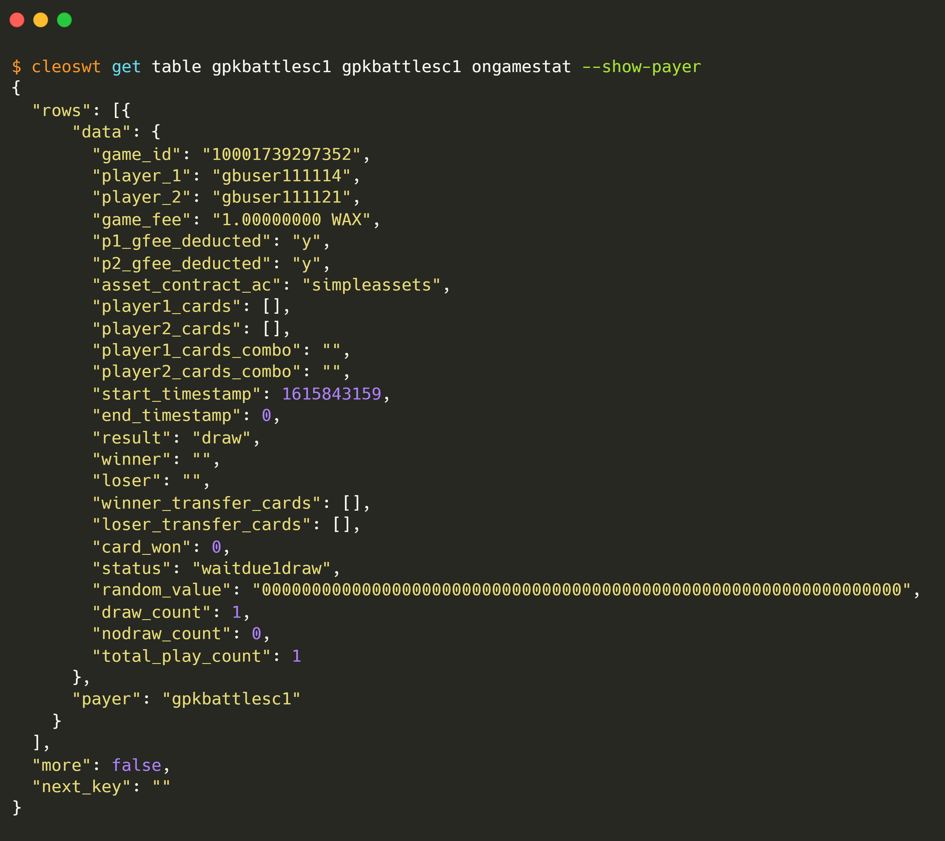
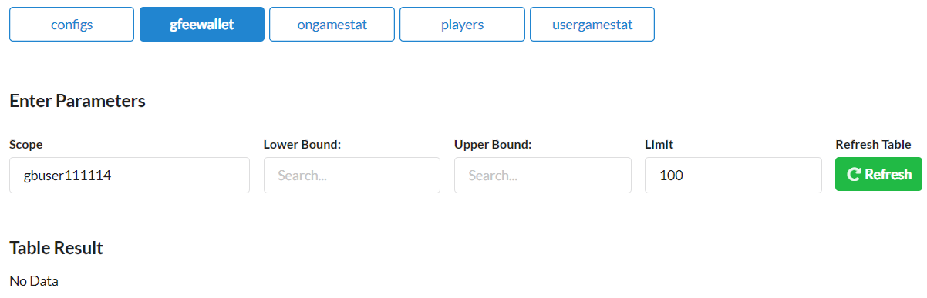
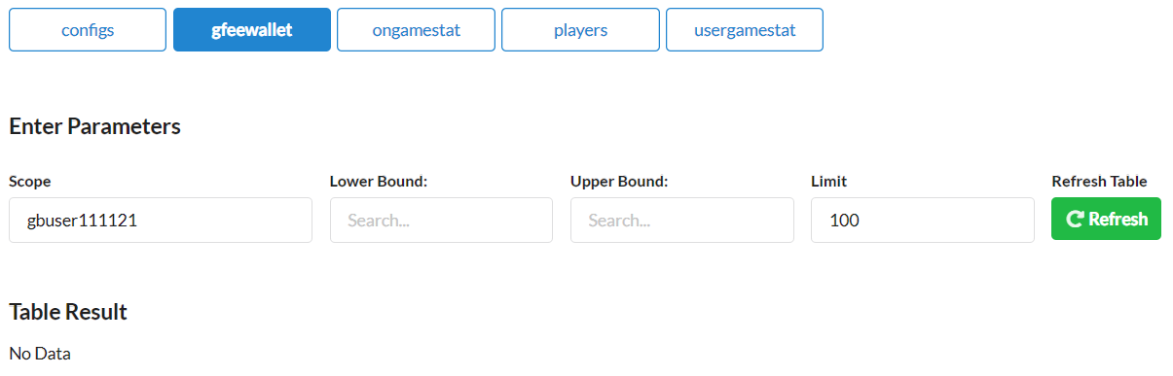
4.
gbuser111114
plays
Pre
Activity
Post
ongamestat
ongamestat
gfeewallet
gfeewallet

Slide 8
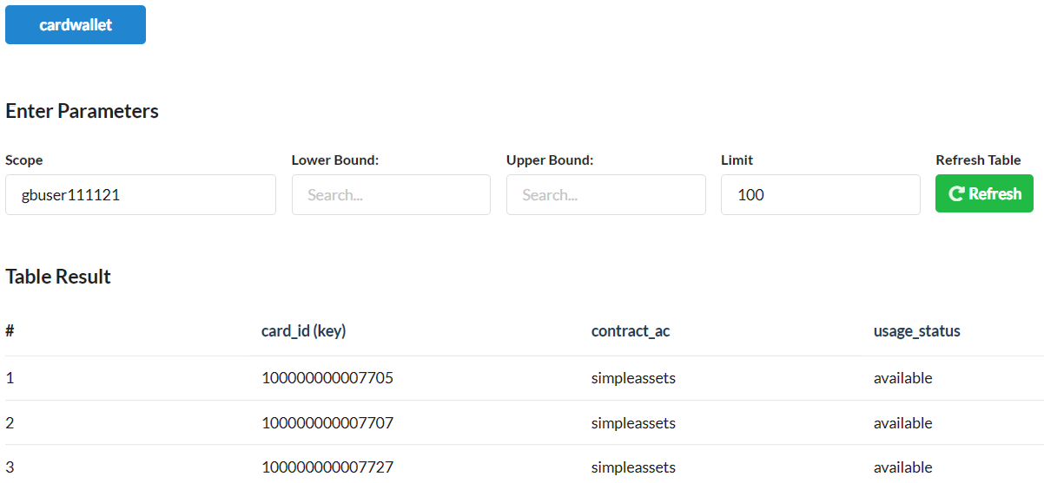
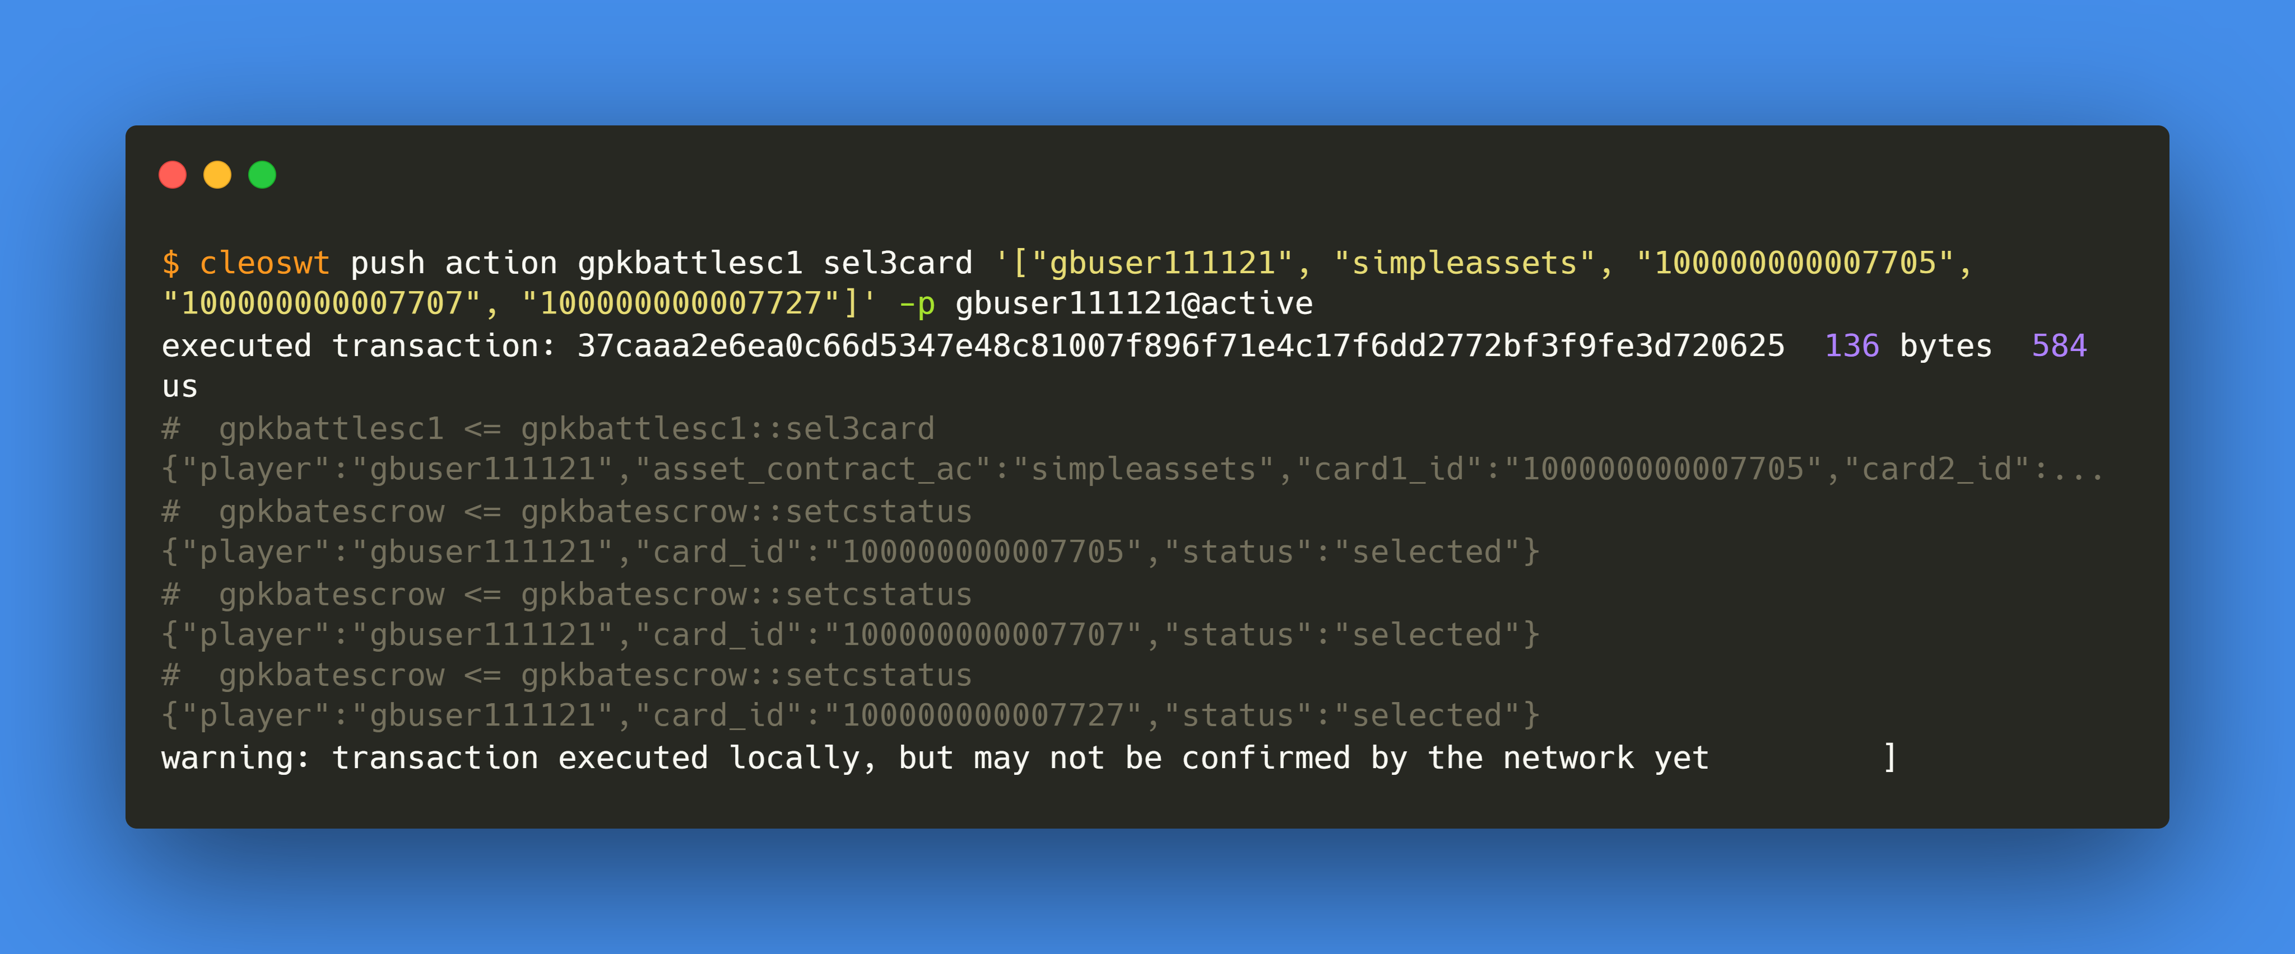


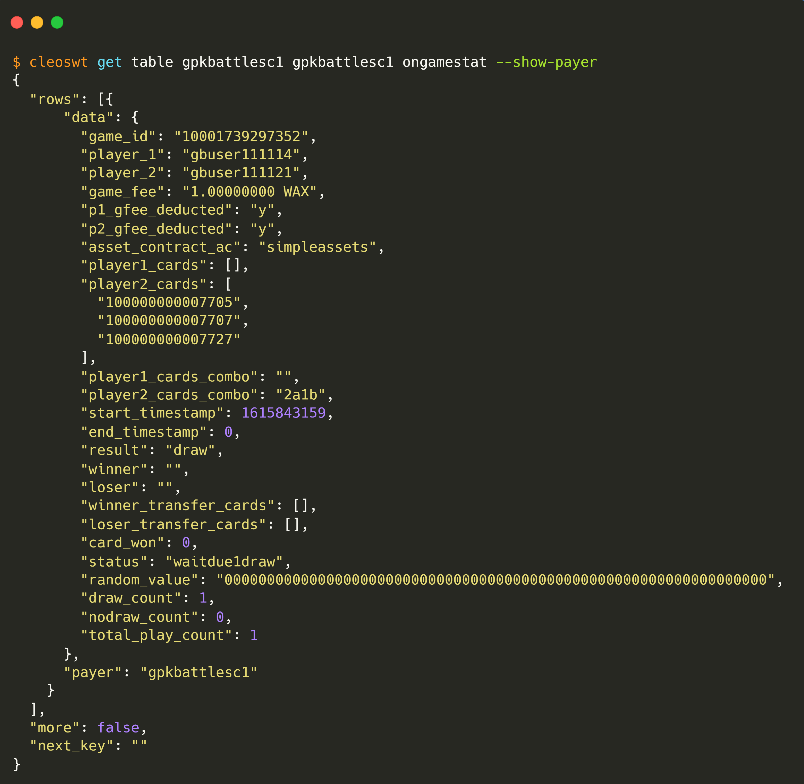

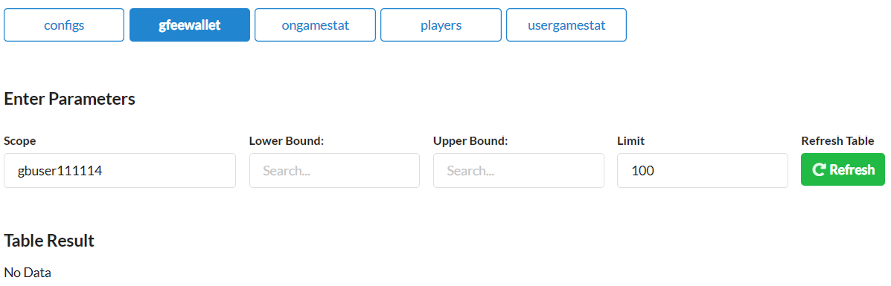
5.
gbuser111121
select 3 cards, but
gbuser111114
doesn’t
Pre
Activity
Post
cardwallet
cardwallet
ongamestat
gfeewallet
gfeewallet
players
players

Slide 9
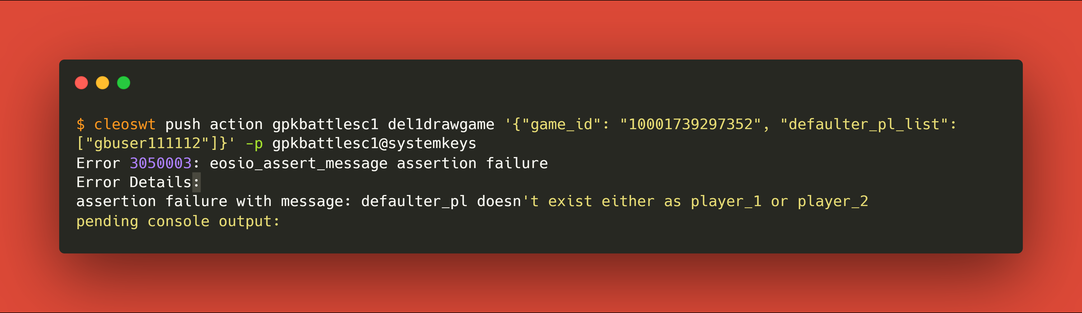
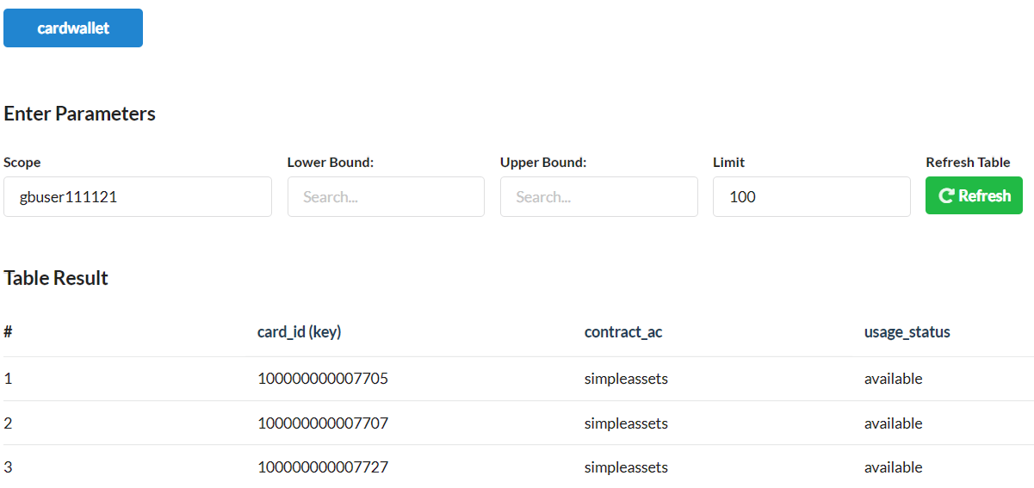
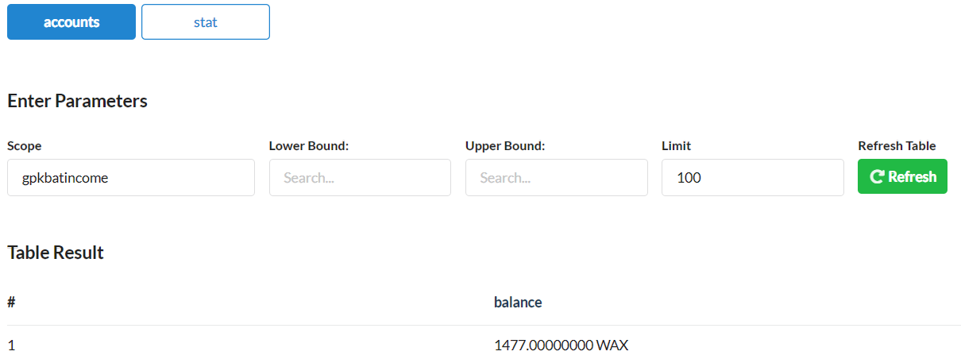

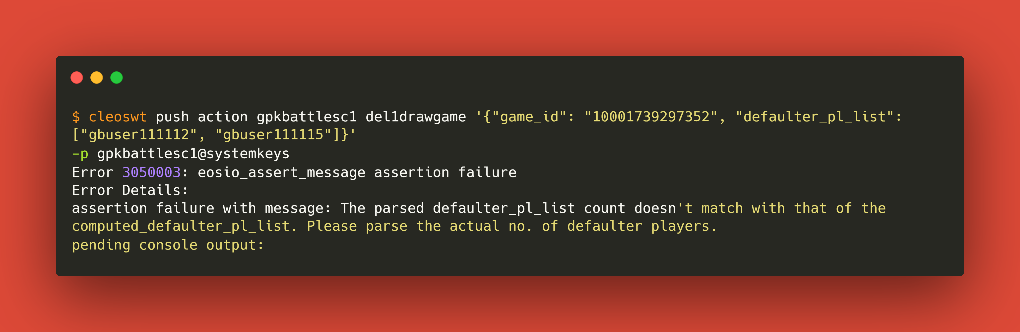
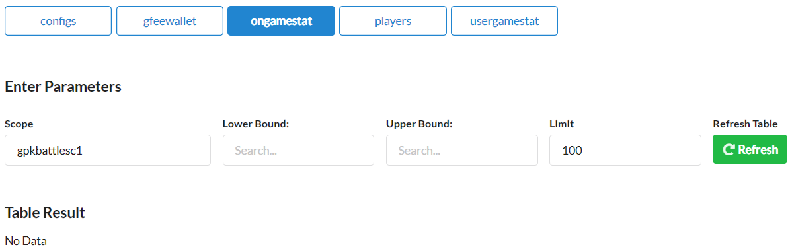
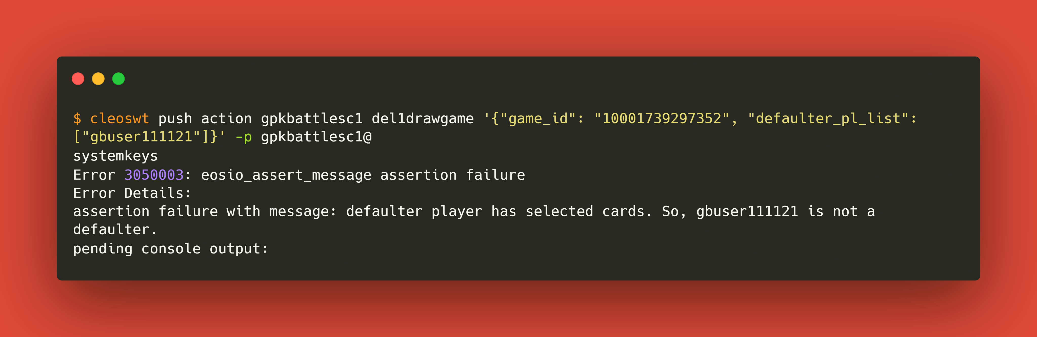
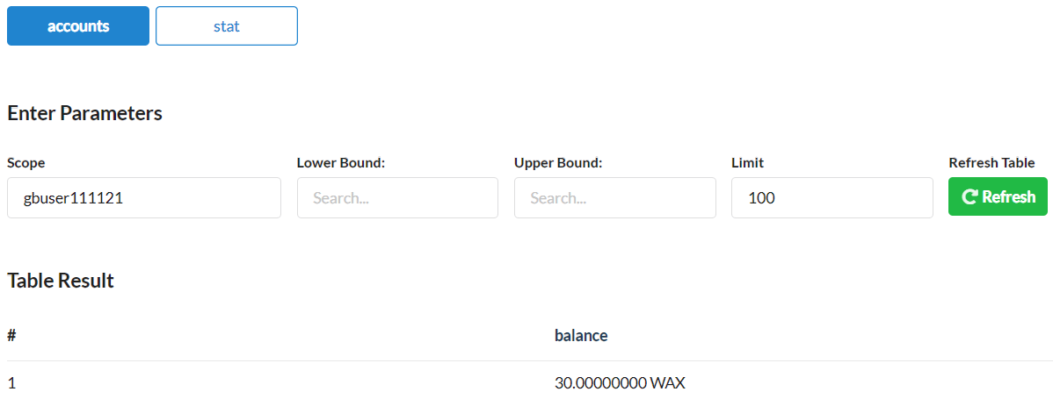
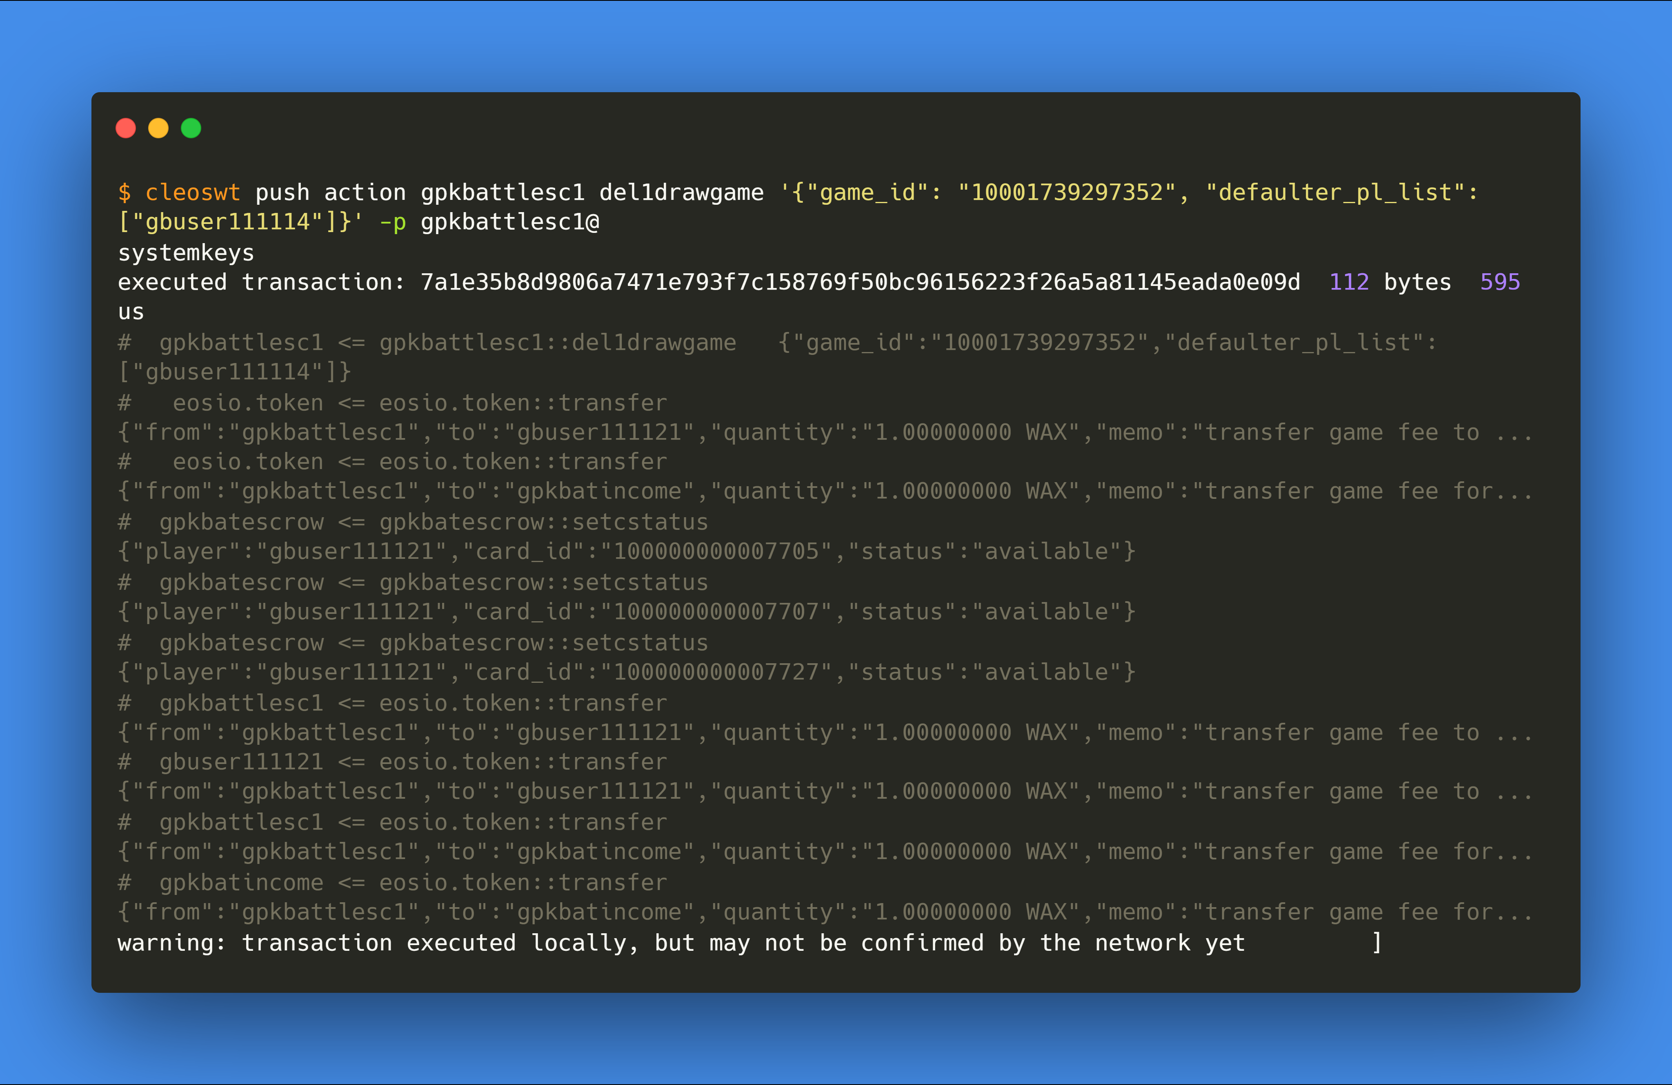
6.
After 1-draw, delete game row for at least 1 defaulter i.e.
gbuser111114
Pre
Activity
Post
cardwallet
accounts
cardwallet
accounts
ongamestat
ongamestat
gfeewallet
gfeewallet
players
players

Slide 10
RUN-5
Case-1.2: when no player select cards => 2 defaulters

Slide 11
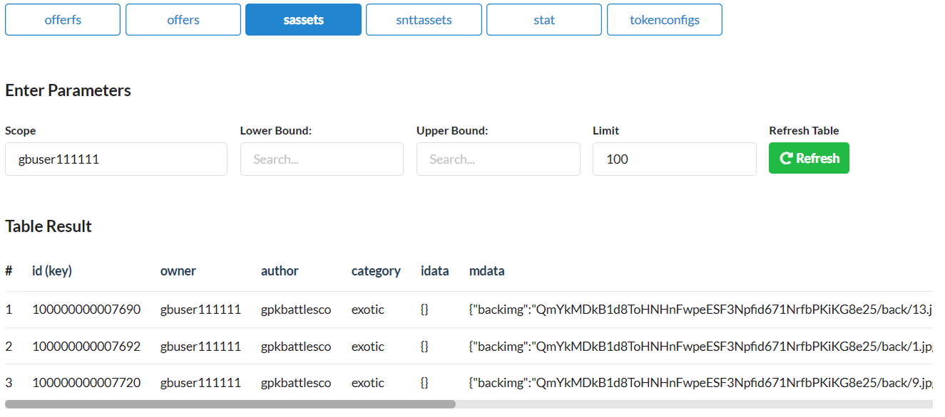
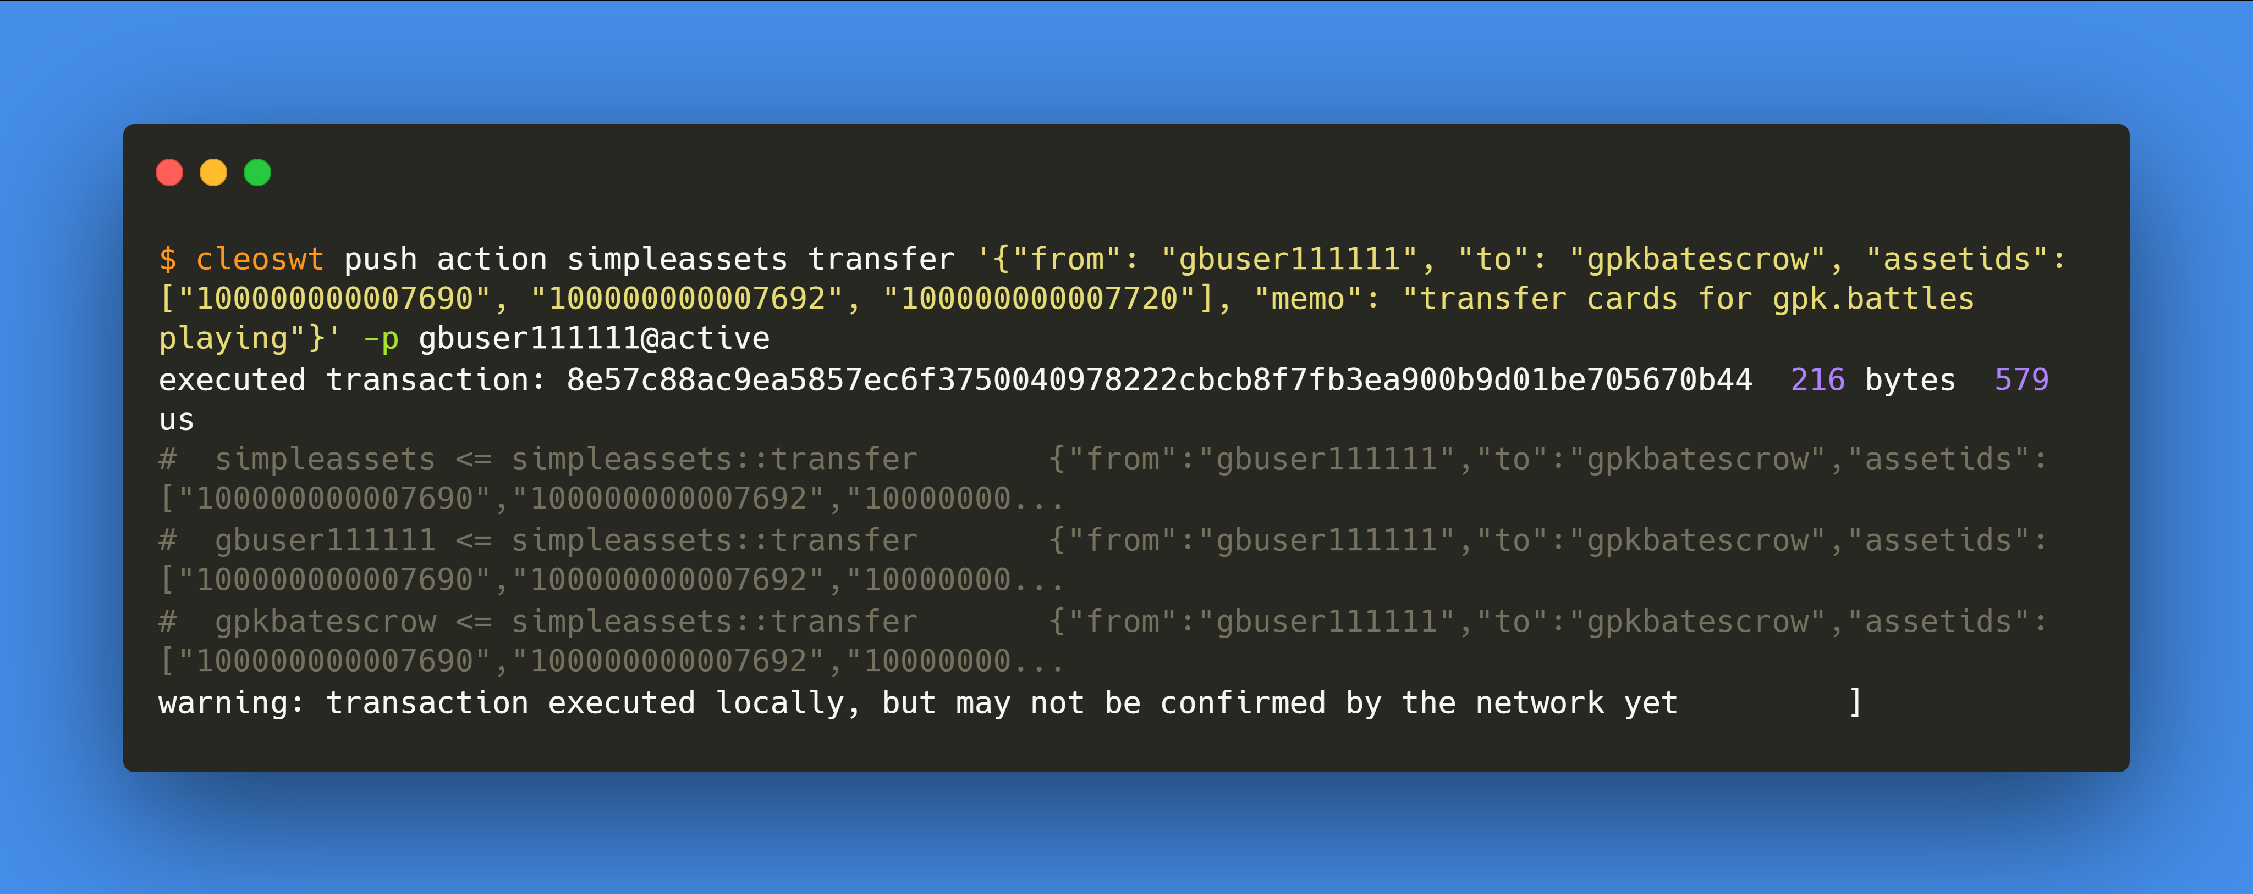
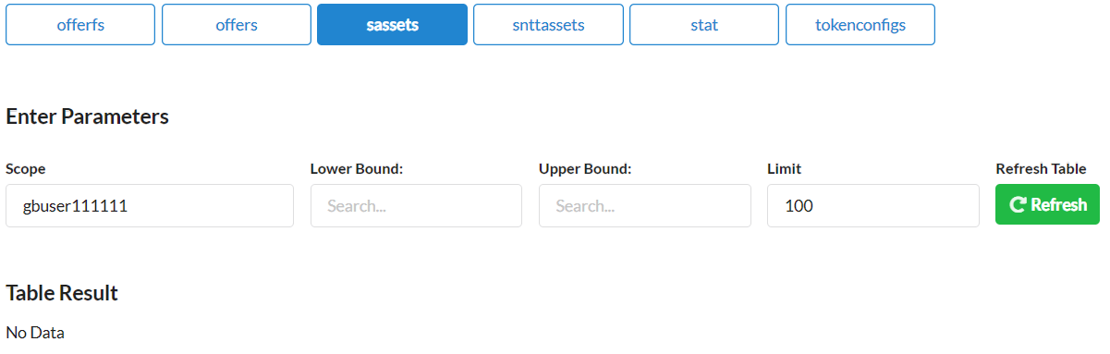
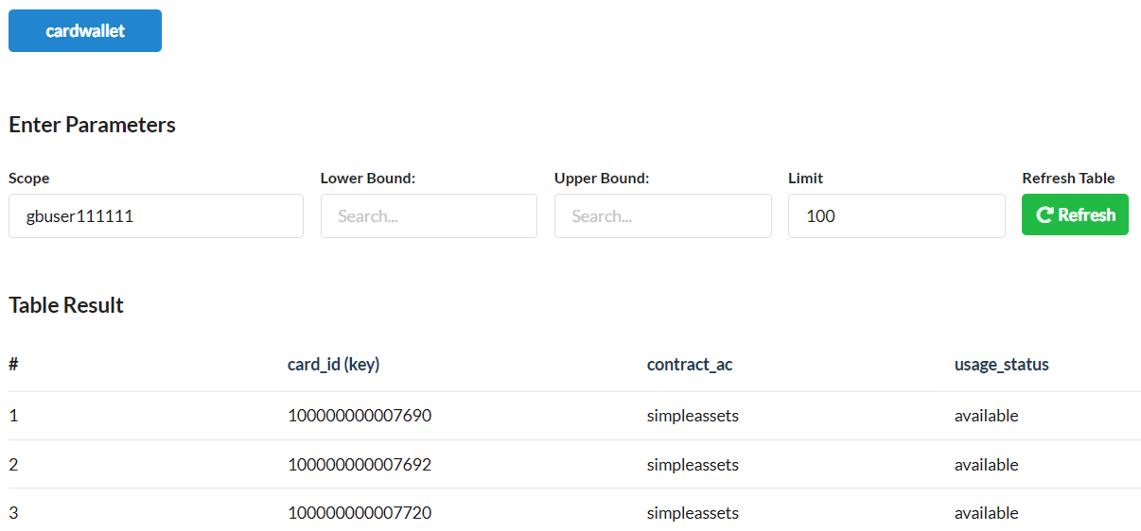
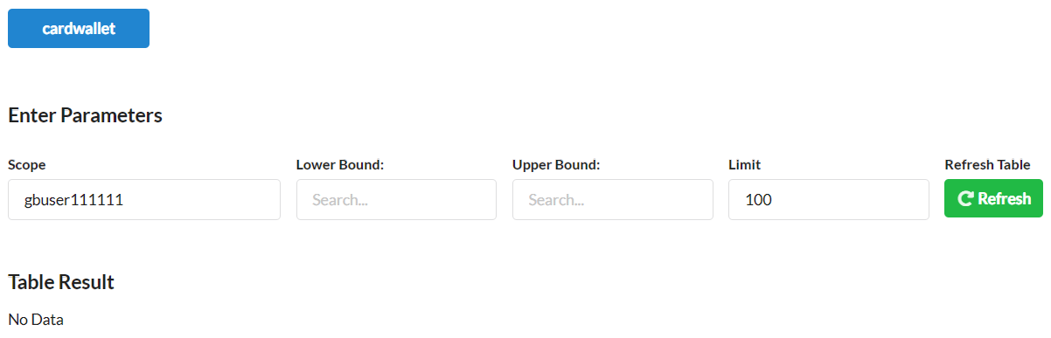
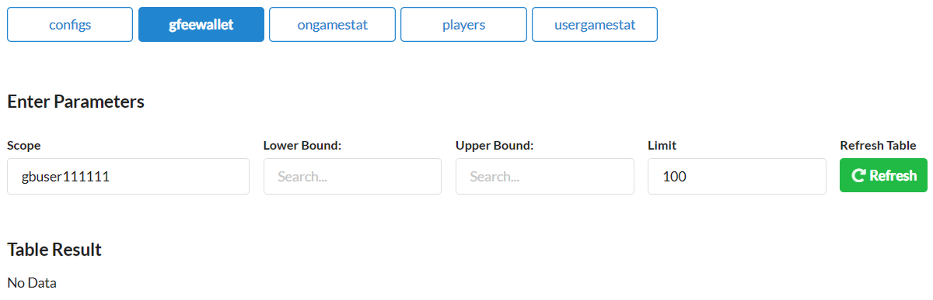
1.
gbuser111111
transfer desired cards to escrow contract
gpkbatescrow
Pre
Activity
Post
sassets
sassets
cardwallet
cardwallet
gfeewallet
gfeewallet

Slide 12

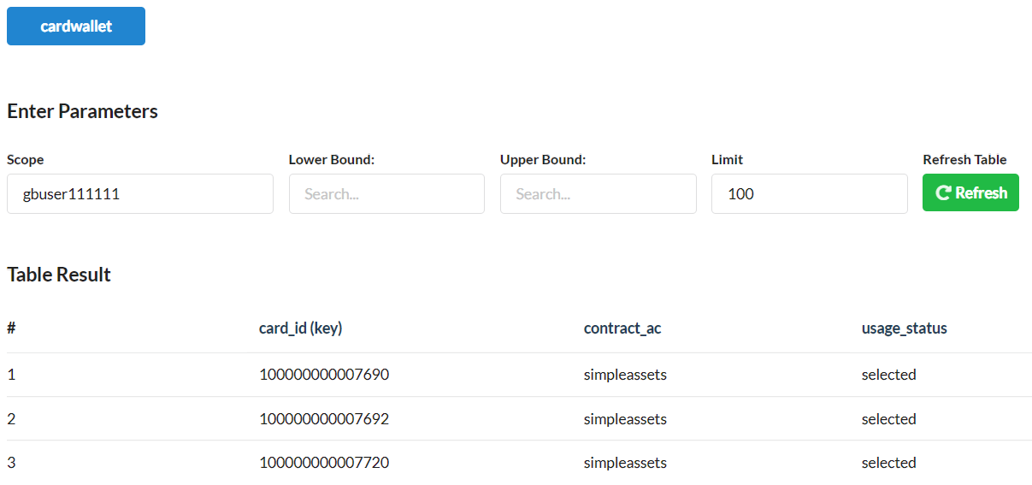

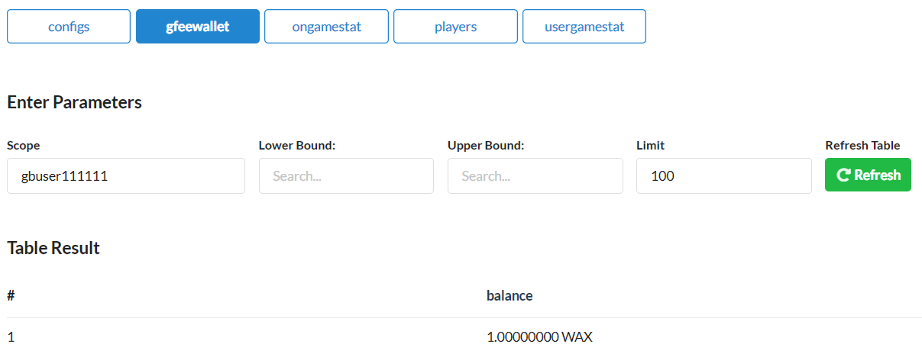
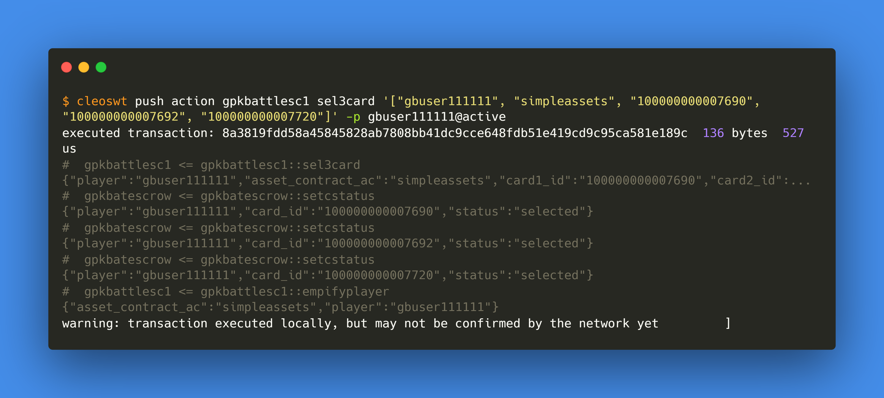
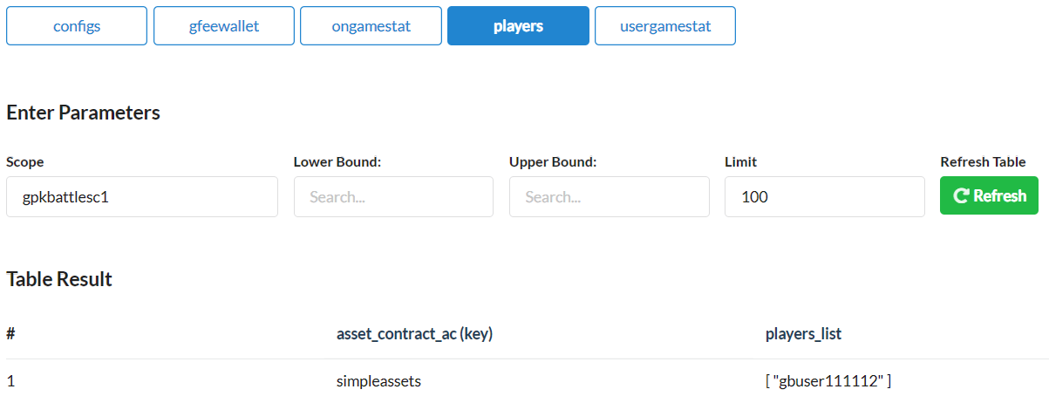
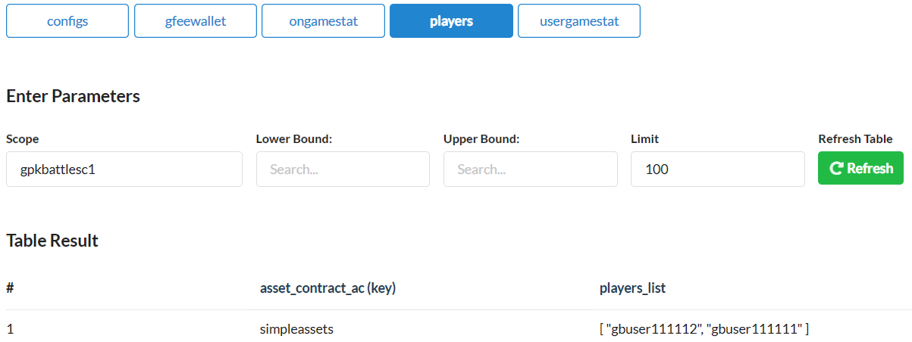
2.
gbuser111111
select 3 cards
Pre
Activity
Post
cardwallet
cardwallet
gfeewallet
gfeewallet
players
players

Slide 13
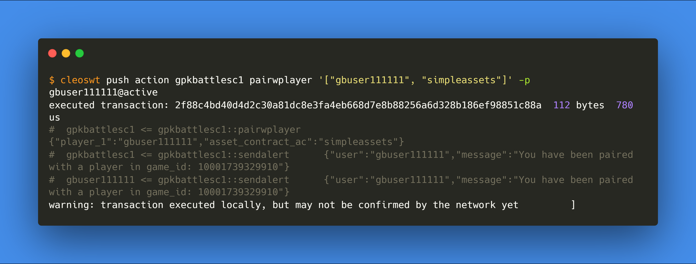
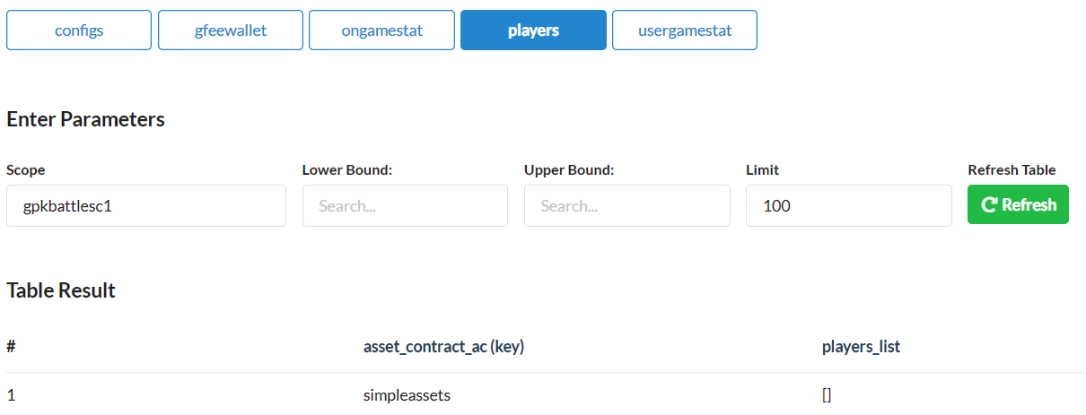
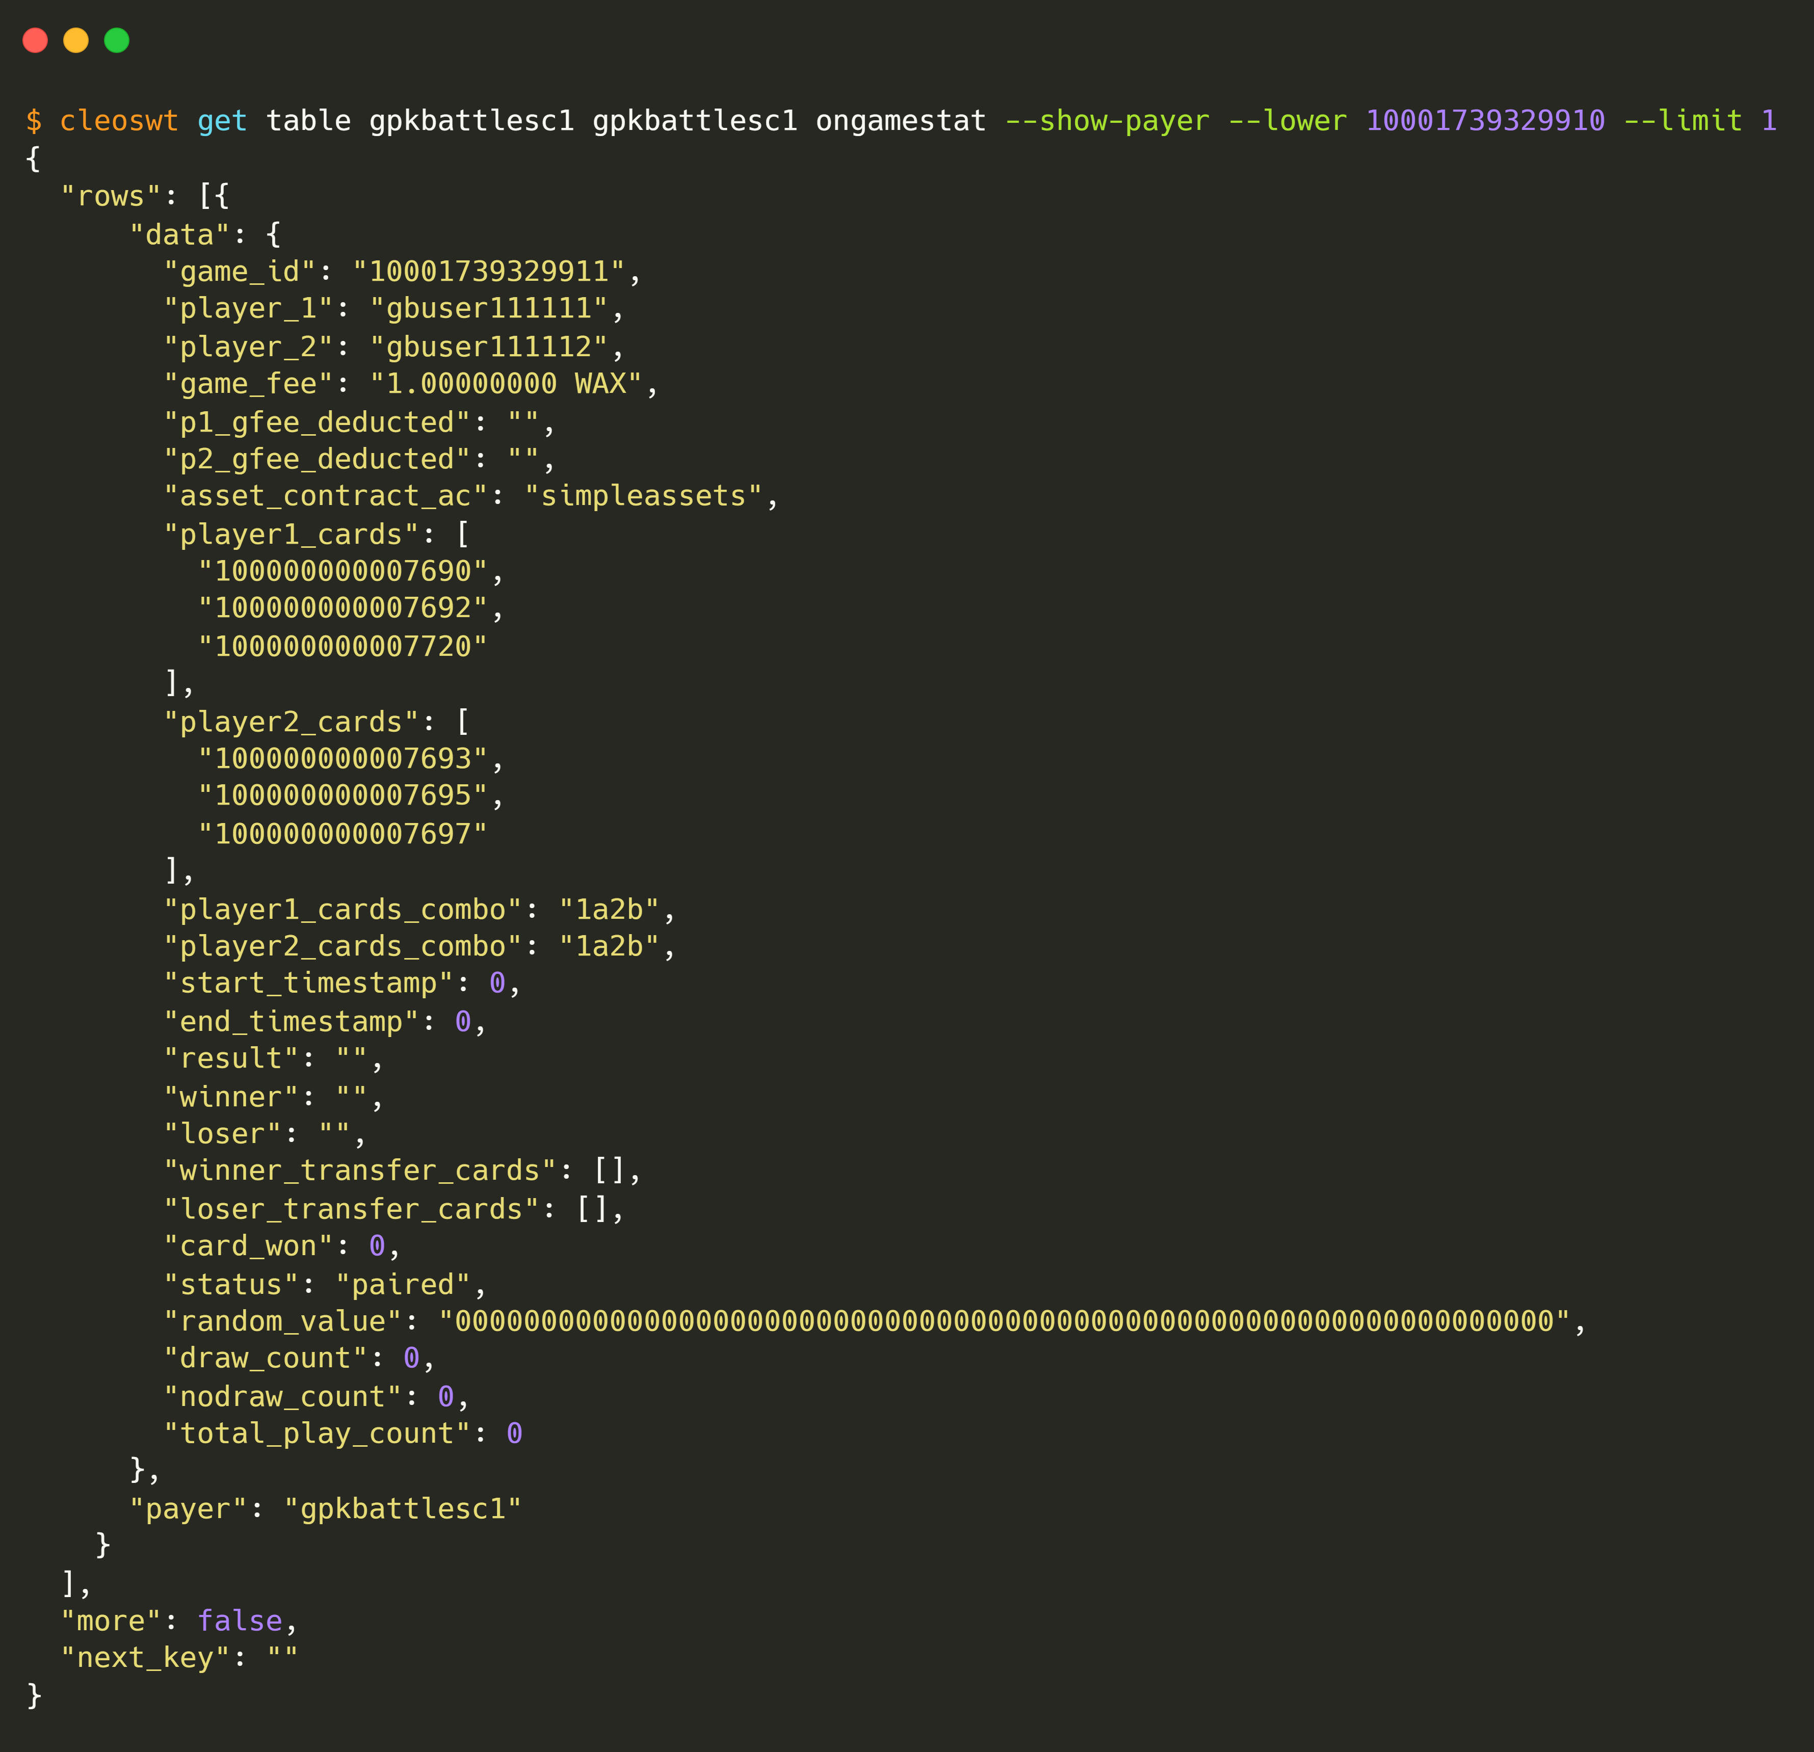
3.
gbuser111113
pairs with a player
Pre
Activity
Post
players
players
ongamestat
ongamestat
gfeewallet
gfeewallet

Slide 14
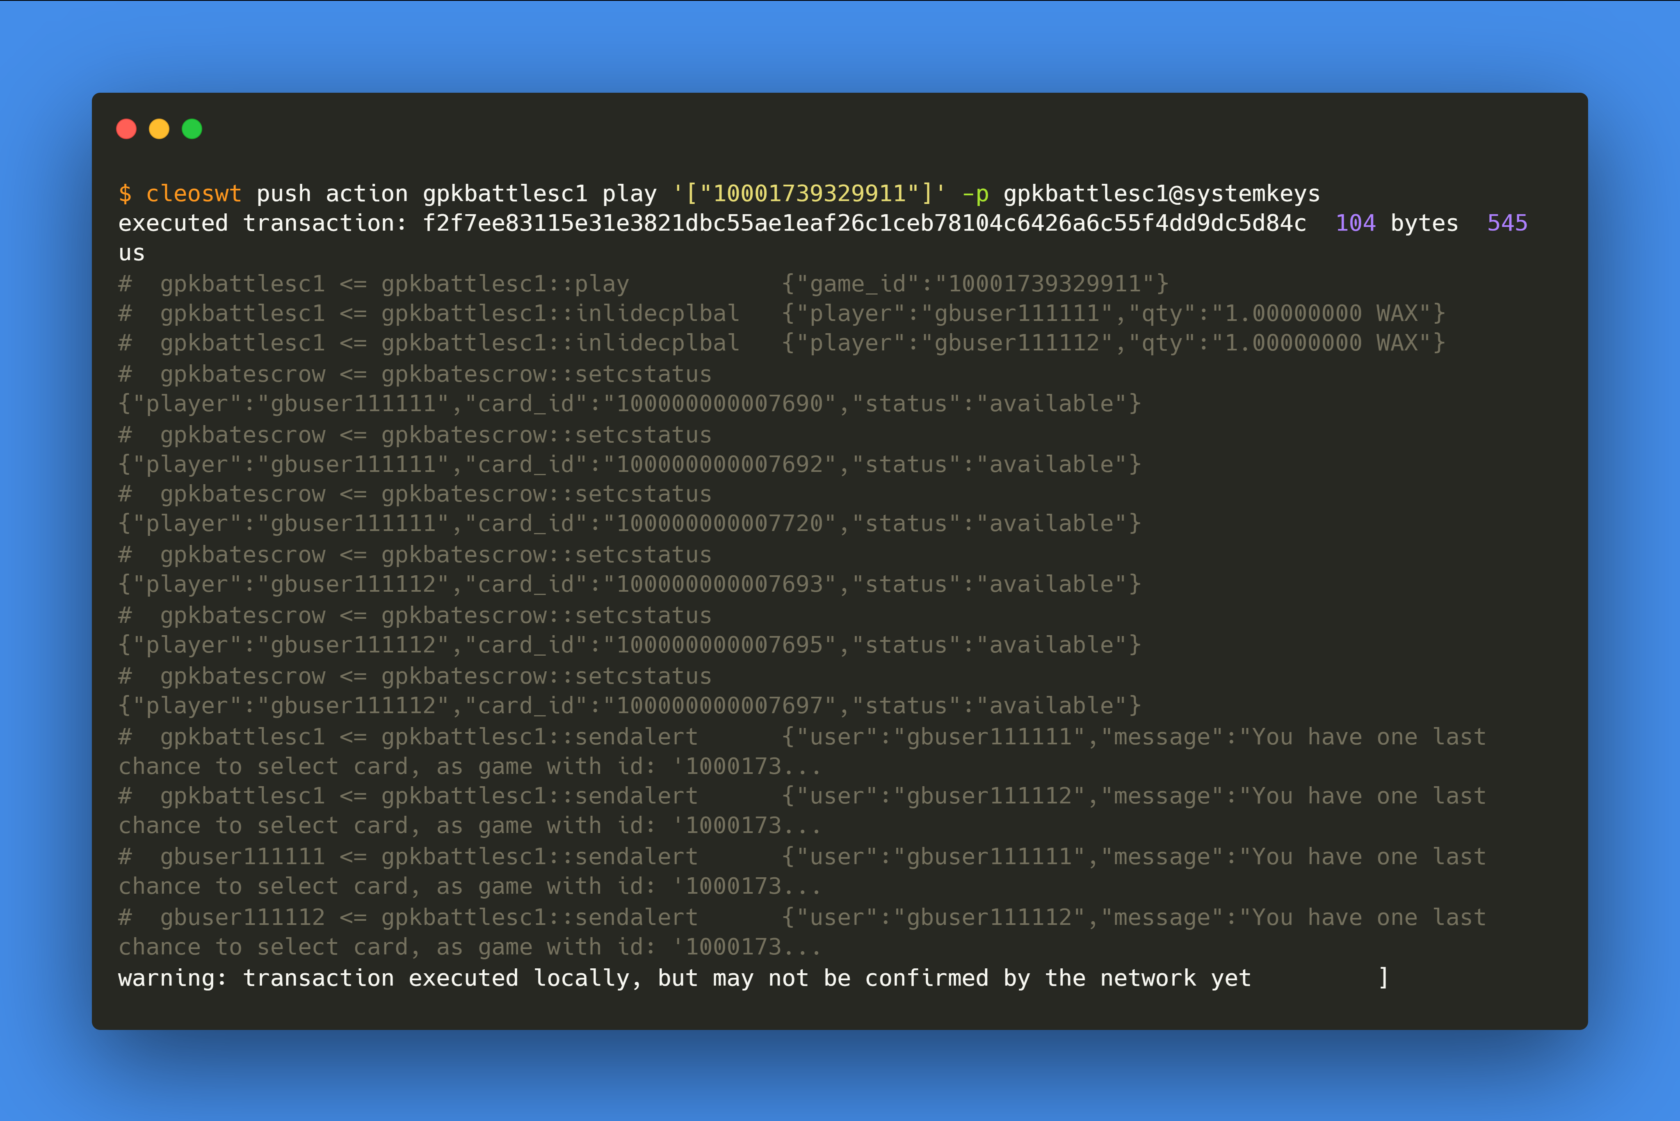
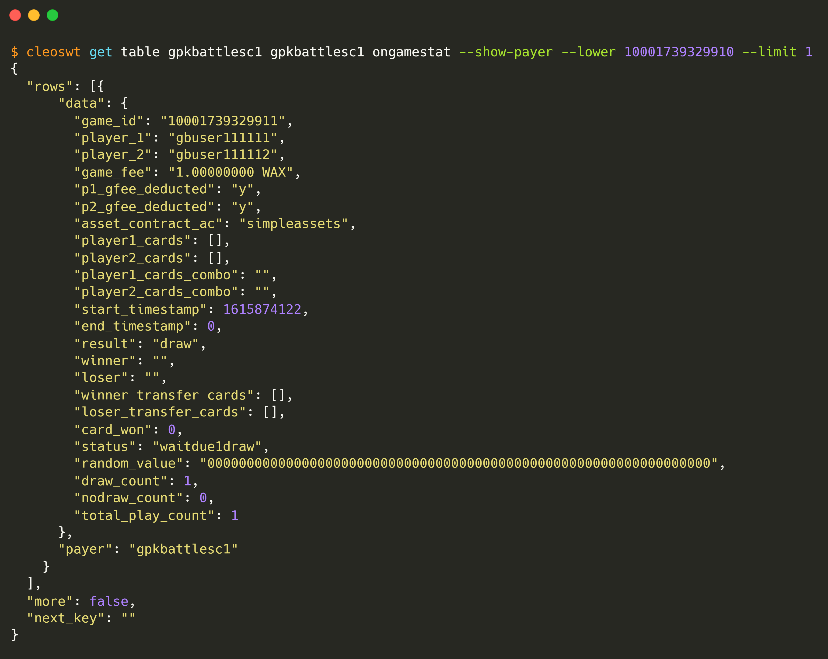
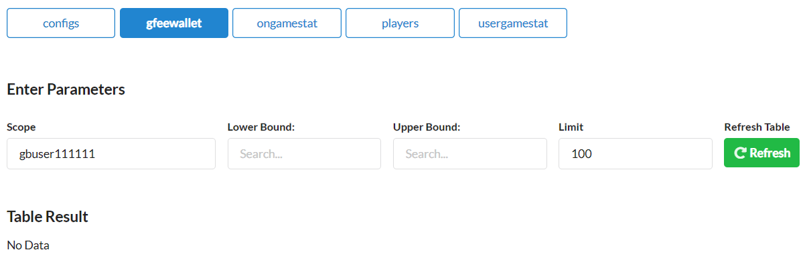

4.
gbuser111113
plays
Pre
Activity
Post
ongamestat
ongamestat
gfeewallet
gfeewallet

Slide 15










6.
After 1-draw, delete game row for 2 defaulters as none select cards & their deducted game_fee is transferred to gpkbatincome
Pre
Activity
Post
cardwallet
accounts
cardwallet
accounts
ongamestat
ongamestat
gfeewallet
gfeewallet
players
players

Slide 16
RUN-6
Case-2.2: 1-draw >> nodraw

Slide 17






1.
gbuser111115
transfer desired cards to escrow contract
gpkbatescrow
Pre
Activity
Post
sassets
sassets
cardwallet
cardwallet
gfeewallet
gfeewallet

Slide 18





2.
gbuser111115
select 3 cards
Pre
Activity
Post
cardwallet
cardwallet
gfeewallet
gfeewallet
players
Only gbuser111115 gets added in players_list table
players

Slide 19



3.
gbuser111115
pairs with a player
Pre
Activity
Post
players
players
ongamestat
ongamestat
gfeewallet
gfeewallet

Slide 20






4.
gbuser111115
plays
Pre
Activity
Post
ongamestat
ongamestat
cardwallet
gfeewallet
gfeewallet

Slide 21











5.
gbuser111115
gbuser111112
select 3 cards again
Pre
Activity
Post
cardwallet
cardwallet
gfeewallet
gfeewallet
ongamestat
players
players

Slide 22








6.
gbuser111115
play again for last time
Pre
Activity
Post
ongamestat
ongamestat
players
accounts
cardwallet
cardwallet
players

Slide 23









7.
Disburse nodraw cards by
gpkbattlesco
contract account
Pre
Activity
Post
ongamestat
accounts
ongamestat
usergamestat
players
accounts
cardwallet
usergamestat
cardwallet
players

Slide 24

THANKS

